Slide 1
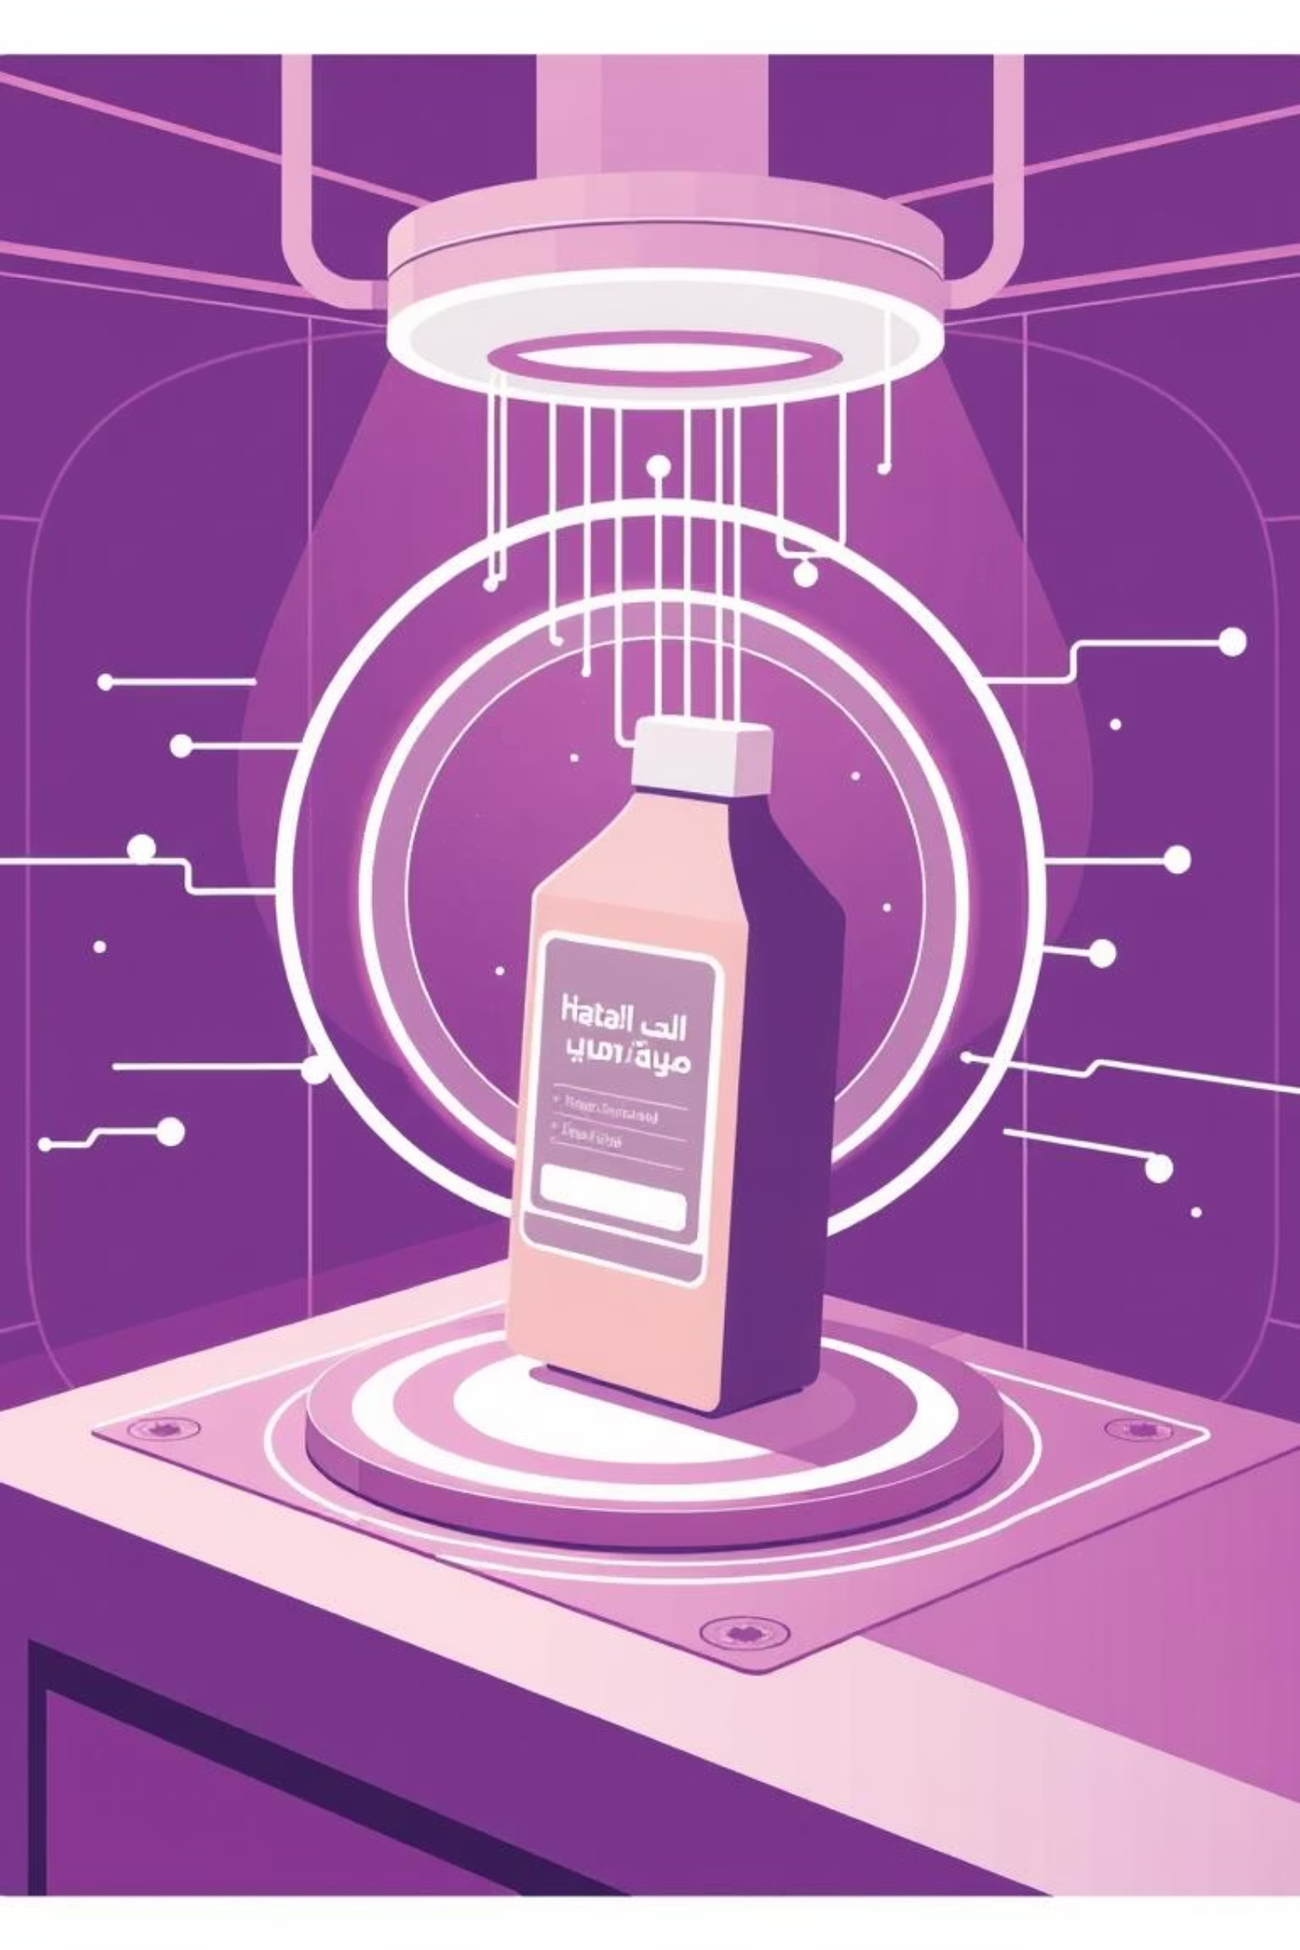
Halal Product Intelligence System
A Deep Learning Approach for Automated Product Classification
Notes:
This system uses advanced deep learning techniques to automatically classify products as halal or non-halal The AI-powered image analysis can quickly scan products and determine if they meet halal certification requirements Detailed data analysis provides insights into product ingredients, manufacturing processes, and compliance Glowing lines and futuristic visuals highlight the cutting-edge technology powering this intelligent system This solution helps businesses and consumers quickly identify halal-certified products with confidence

Slide 2

Automating Halal Verification
This system uses computer vision and deep learning to automate halal certification verification, integrating three models:
1
2
CNN-based Text Classifier
MobileNetV2 Transfer Learning
For ingredient analysis using TextVectorization and convolutional layers.
For halal logo detection.
3
LSTM-based Barcode Classifier
For barcode status classification.

Slide 3
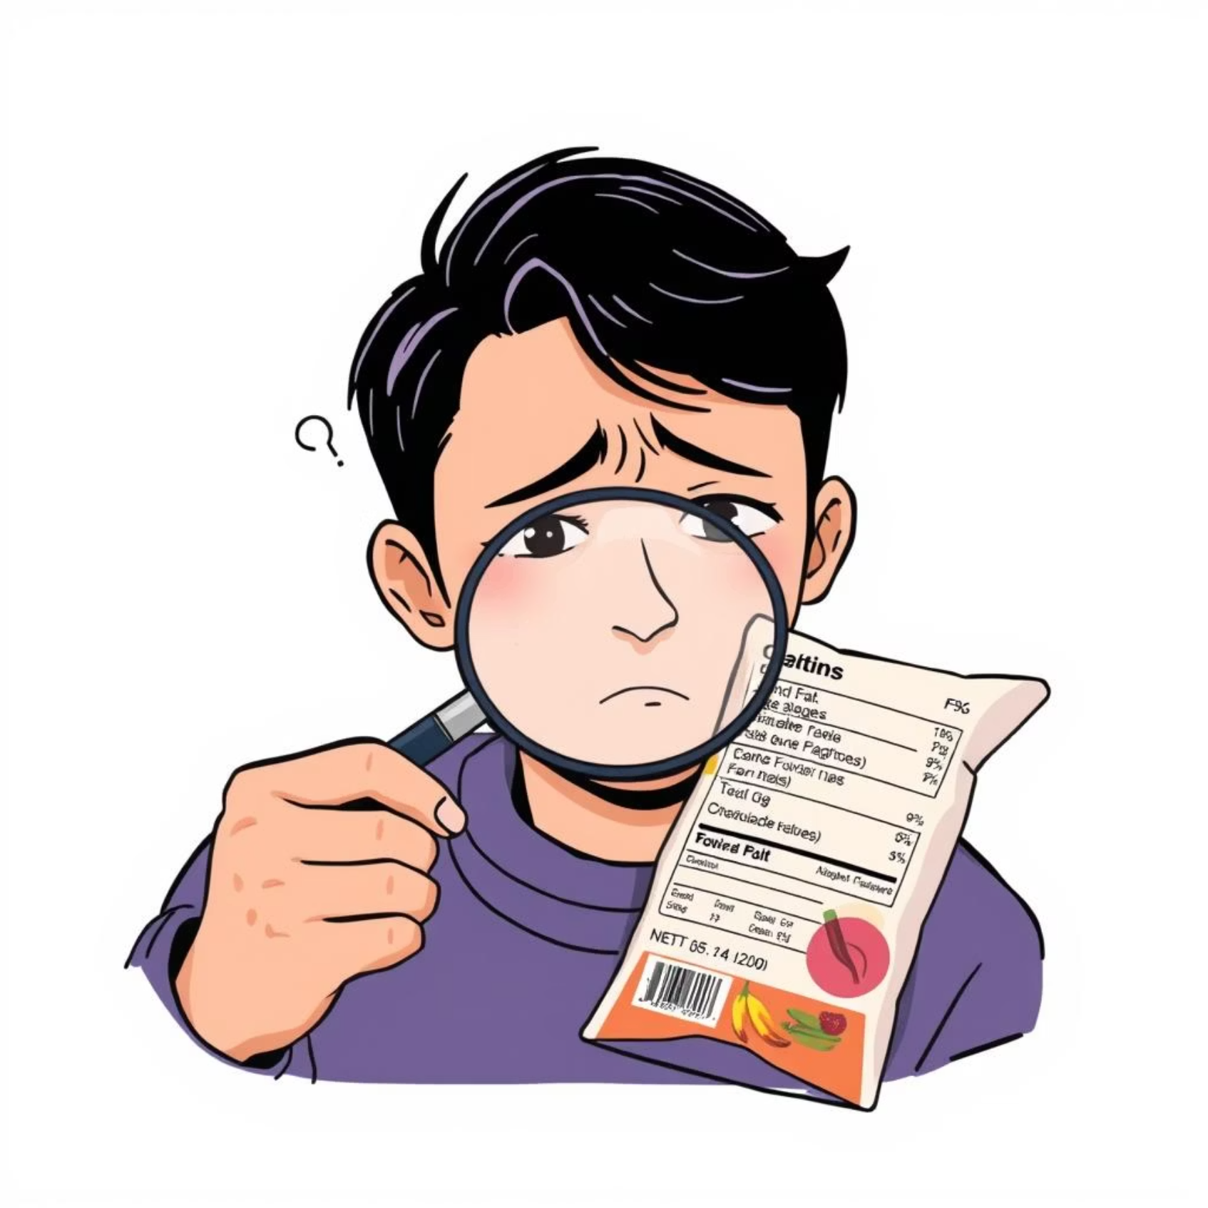
Addressing Market Challenges
The global halal market, valued at over $2 trillion, faces challenges in manual verification.
Complex Ingredients
Lengthy lists and cryptic E-codes complicate manual checks.
Lack of Clear Labeling
Manufacturers may not provide explicit halal labeling.
Human Error
Traditional methods are time-consuming and prone to mistakes.

Slide 4
Key Contributions
Comprehensive Pipeline
1
Unified text, logo, and barcode analysis.
Multi-source Dataset
2
39,715 labeled ingredient samples compiled.
Transfer Learning
3
MobileNetV2 fine-tuned for 87% logo detection accuracy.
Hybrid Approach
4
Keyword heuristics combined with learned representations.
Deployment-ready
5
Exportable TensorFlow models for mobile/web.

Slide 5

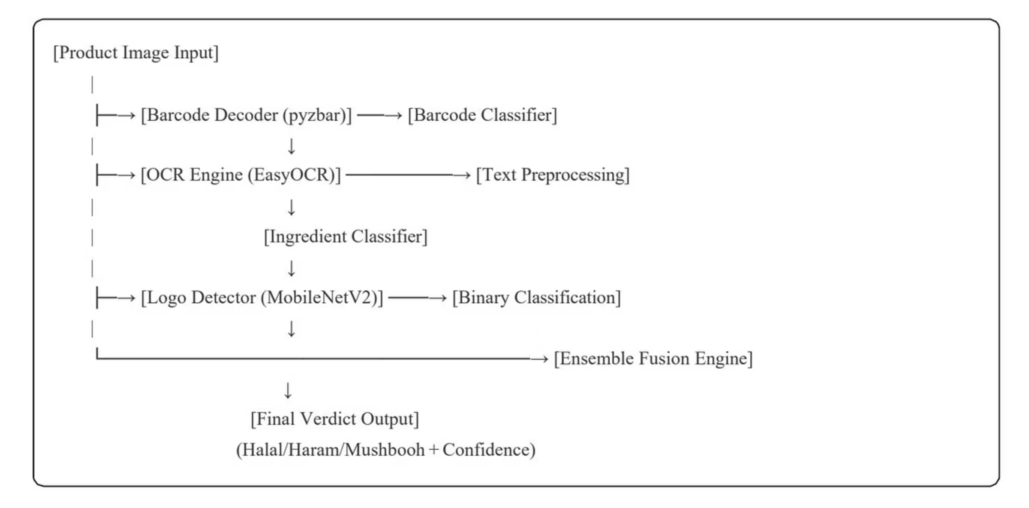
System Architecture
The pipeline consists of five integrated modules operating sequentially on product images.
This architecture ensures an end-to-end automated verification process.

Slide 6
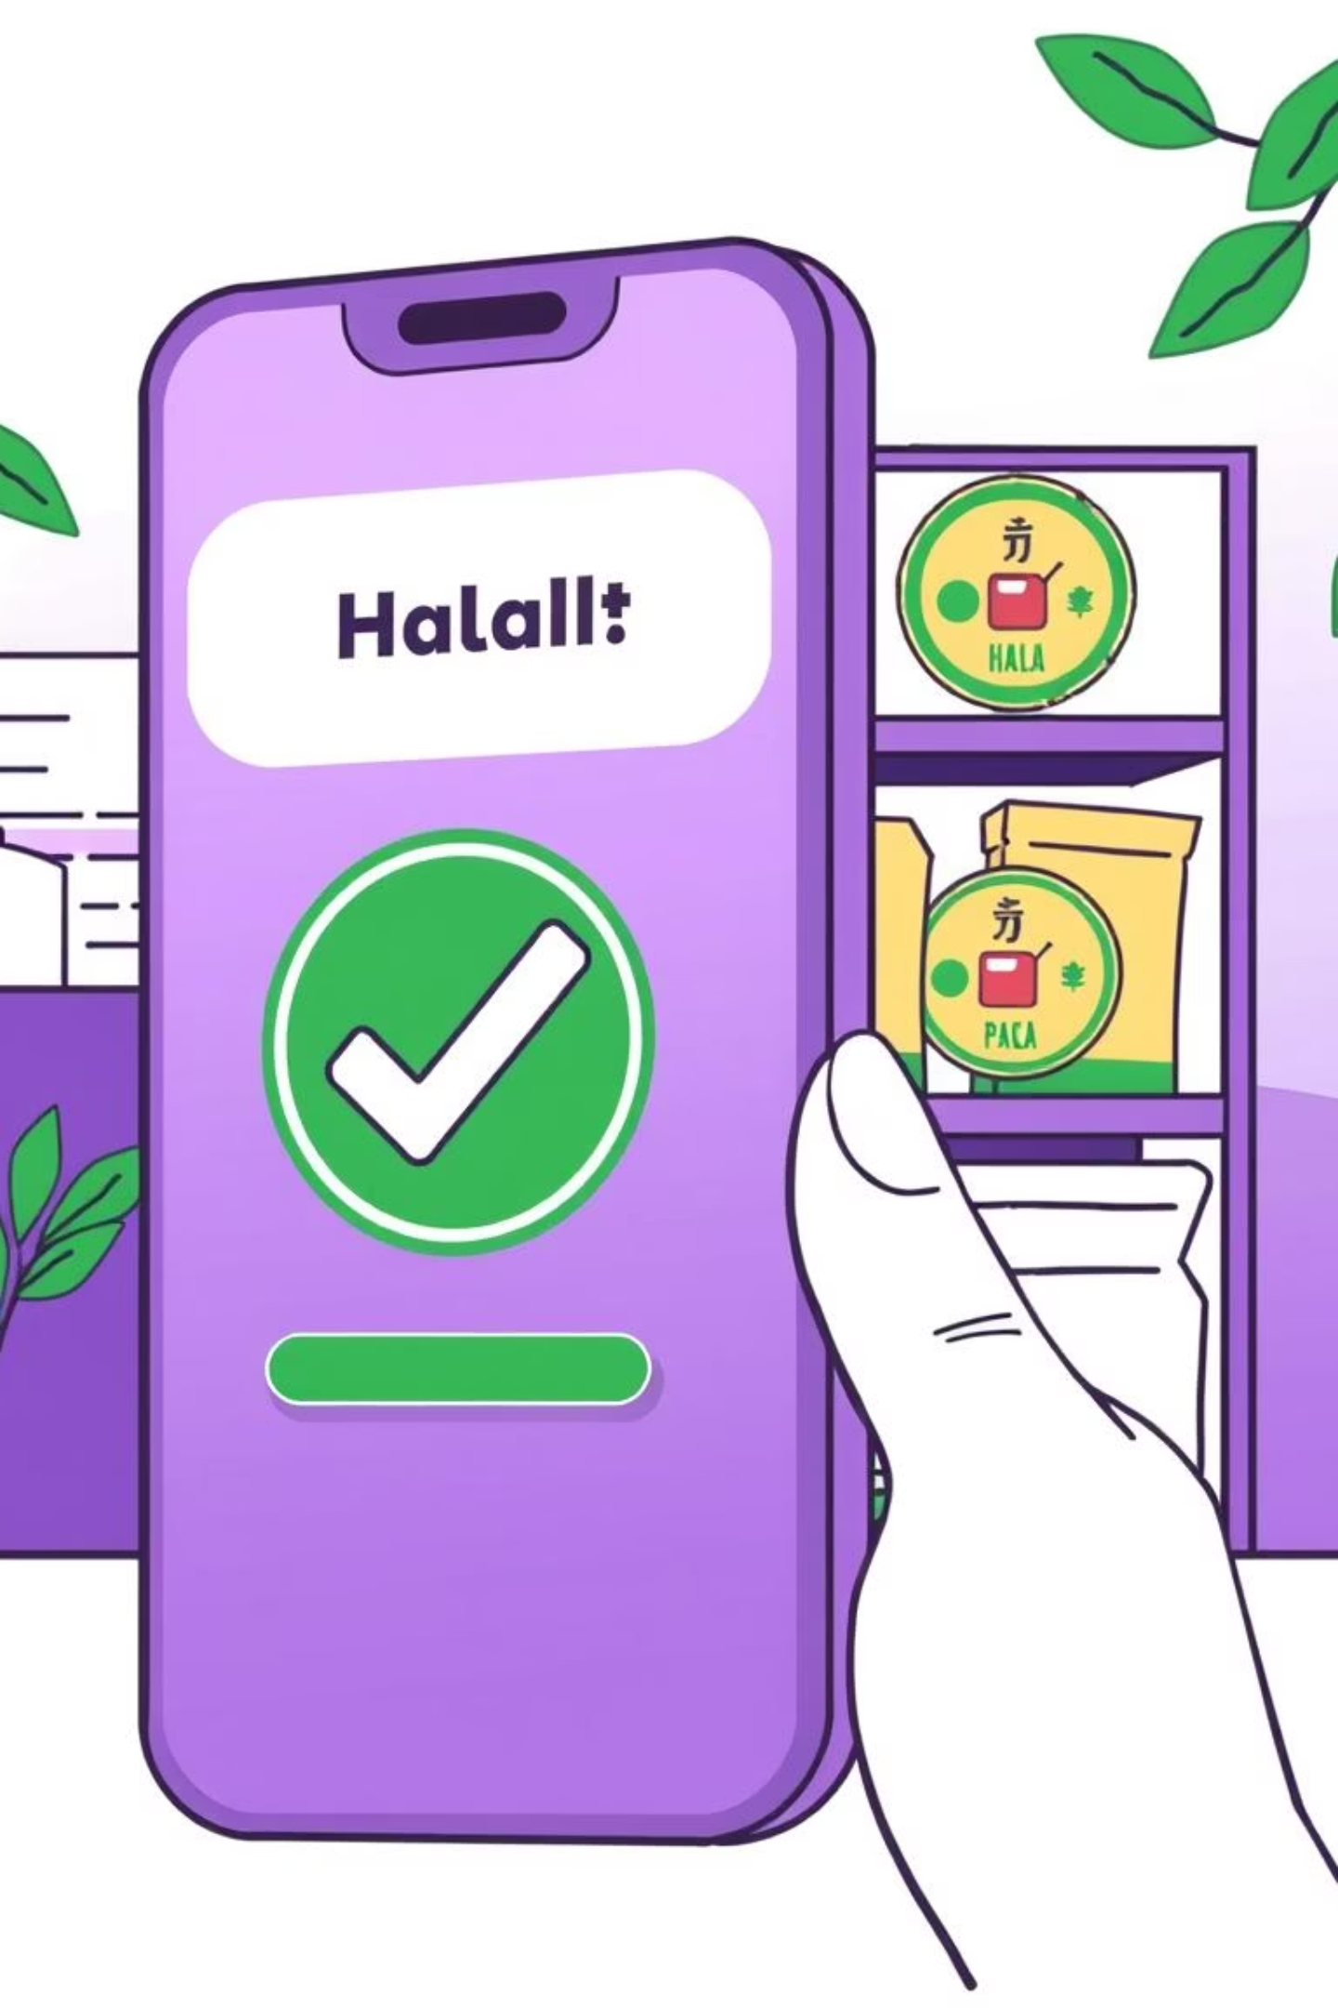
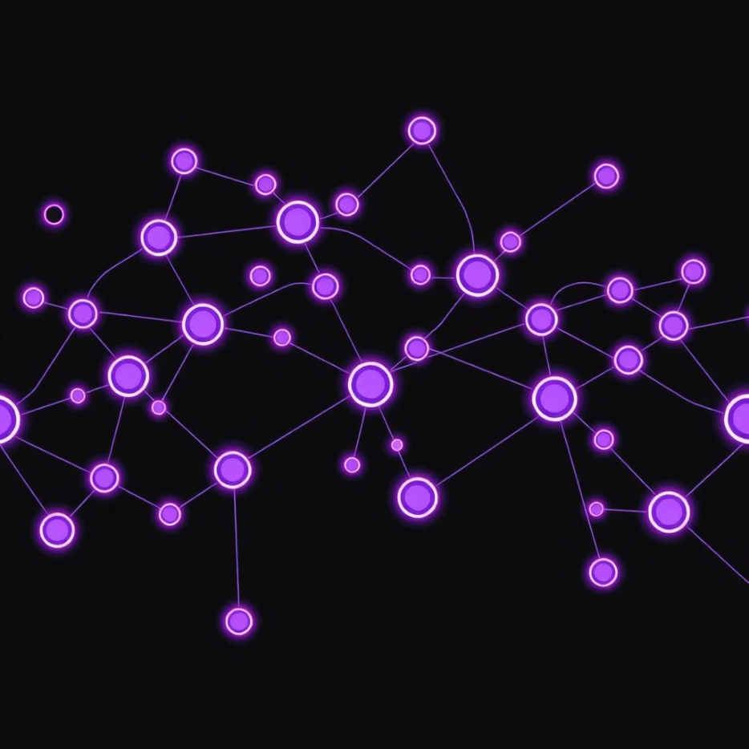
Model Development & Performance
Ingredient Text Classifier
Achieved 99.4% accuracy with an F1-score of 0.99.
Uses TextVectorization + 1D CNN for robust ingredient analysis.
Halal Logo Detector
MobileNetV2 transfer learning model with 87.4% validation accuracy.
Optimized for mobile deployment efficiency.

Slide 7

Ensemble Fusion Logic
The system synthesizes five evidence sources through weighted voting for a final verdict.
This approach mitigates individual model failures and provides interpretable confidence scores.
Precautionary Principle
Tie-breaking prioritizes Haram > Halal > Mushbooh.
Robust Verdicts
Integrates text, image, and barcode data for comprehensive analysis.

Slide 8




Conclusion & Future Work
This system offers a practical solution for AI-assisted dietary compliance.
Foundational Infrastructure
Lays groundwork for AI-assisted dietary compliance.
Address Limitations
Focus on Mushbooh data, logo generalization, and optimal fusion weights.
Enhance Granularity
Integrate knowledge graphs for ingredient derivations.

